Slide 1
External Interrupts in Atmega328
Dr.Sreejith Rajan

Slide 2
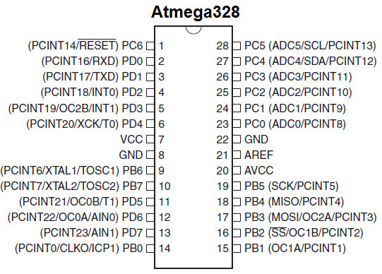
External Interrupts
INT0
INT1
1

Slide 3
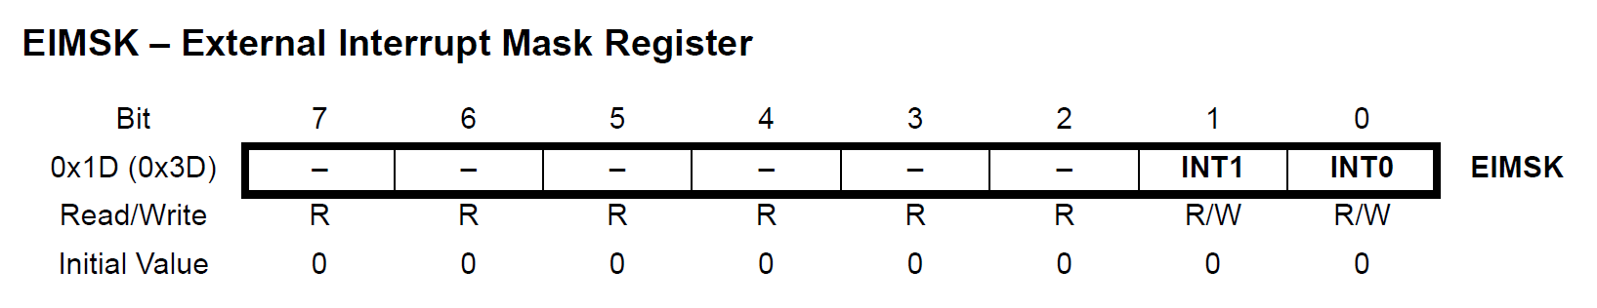
Registers Involved - External Interrupt Mask Register
INTO bit = 1 enables external interrupt 0
INT1 bit =1 enables external interrupt 1
1

Slide 4
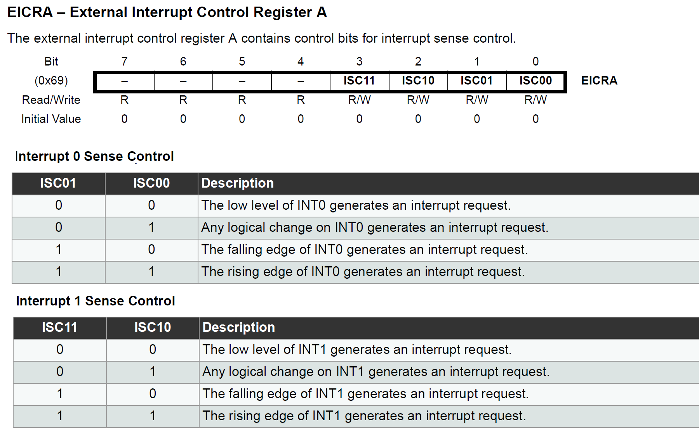
EICRA – External Interrupt Control Register A
This decides on what type of input , the interrupt should be activated
1

Slide 5
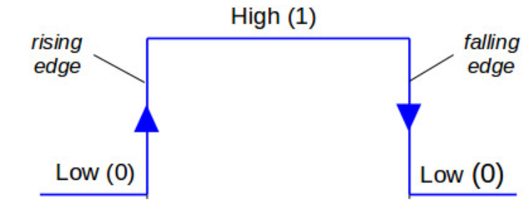
Signal Status

Slide 6

Status Register -SREG
Remember sei()
1

Slide 7

External Interrupt Flag Register (EIFR)
We don’t really use it unless we want to clear it and make sure that nothing previous is there by accident.
We can also use it for debugging.

Slide 8
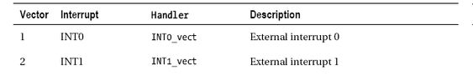
INTERRUPT VECTOR TABLE FOR INT0 AND INT1

Slide 9
General Process of Interrupt Programming (ATmega328)
Step 1 – Enable Global Interrupts
Step 2 – Configure the Peripheral or Source
Depending on the interrupt source:
External interrupt (INT0/INT1) → configure EICRA (trigger type).
Timer interrupt → configure TCCR0x/TCCR1x/TCCR2x (mode, prescaler).
ADC/USART/etc. → configure their control registers.
1

Slide 10
General Process of Interrupt Programming (ATmega328)
Step 3 – Enable the Interrupt in Mask Register
Each peripheral has its own Interrupt Mask Register:
EIMSK → for external interrupts.
TIMSK0/TIMSK1/TIMSK2 → for timers.
ADCSRA → for ADC interrupt.
Setting the right bit tells the MCU: “Yes, allow this specific interrupt.”
1

Slide 11
General Process of Interrupt Programming (ATmega328)
Step 4 – Write the ISR (Interrupt Service Routine)
Define the function that should run when the interrupt occurs.

Slide 12
General Process of Interrupt Programming (ATmega328)
Step 5 – Main Program Loop
1

Slide 13
THANK YOU

